Slide 1
Unit Testing
.NET Development

Slide 2
Quality Assurance (QA) Testing
QA testing is the process of ensuring that your software is of the highest possible quality for your customers.
QA testing is essential to ensure code works under varying circumstances with different inputs.
QA testing consists of the collection of techniques used to prevent issues with your software product or service.
It combines ideally automated testing as well as manual testing.
How? 2 ways

Slide 3

Manual versus automated testing
Manual testing
Used for ad hoc testing by developers
BUT when performed by skilled and experienced testers who represent different user profiles and use a wide range of devices and operating systems going firstly exploratory through the app and secondly checking all possible test case scenarios manual testing will prove invaluable.
Automated testing
Initial set up is expensive and time consuming and if your app changes regularly, the cost associated with test script maintenance will increase considerably.
Ideal for any test that needs to be performed repeatedly.
BUT it is undoubtedly quicker and will speed up the software development life cycle.

Slide 4
Unit testing
Unit testing is a type of automated software testing that validates whether or not individual units or code components like a function, method, procedure, module, or object perform as expected.
Unit tests are written and carried out by the application developers as first of all automated testing processes.
The tester alias developer knows the internal design of the code component to be tested which makes unit testing a form of white box testing.
Manual or automated?
Why "white box testing"?

Slide 5
Why use unit testing?
Testing every component of an application allows to detect bugs early in the development cycle.
Unit testing reduces bug fixing costs in later phases of the development cycle
Unit testing forces developers to start thinking what might go wrong with their application.
Unit testing creates a mindset for delivering quality.

Slide 6
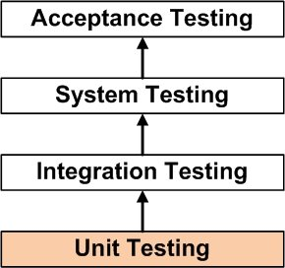
Test levels
Once all the different modules of an application have been unit tested by the developers, testers start with integration testing. In integration testing all interaction between different modules of the software is tested in black box mode.
Next the finished application or so-called system is tested in total in order to check if all the functional and non-functional user requirement specifications are met.

Slide 7
Test levels
Acceptance testing is conducted at the end of the testing process when the application is ready to deliver.
This final testing is performed by end users and customers and focuses on functionality issues or non-working features from the end user’s point of view.
Be aware that profound unit testing is the base of the entire testing process!

Slide 8
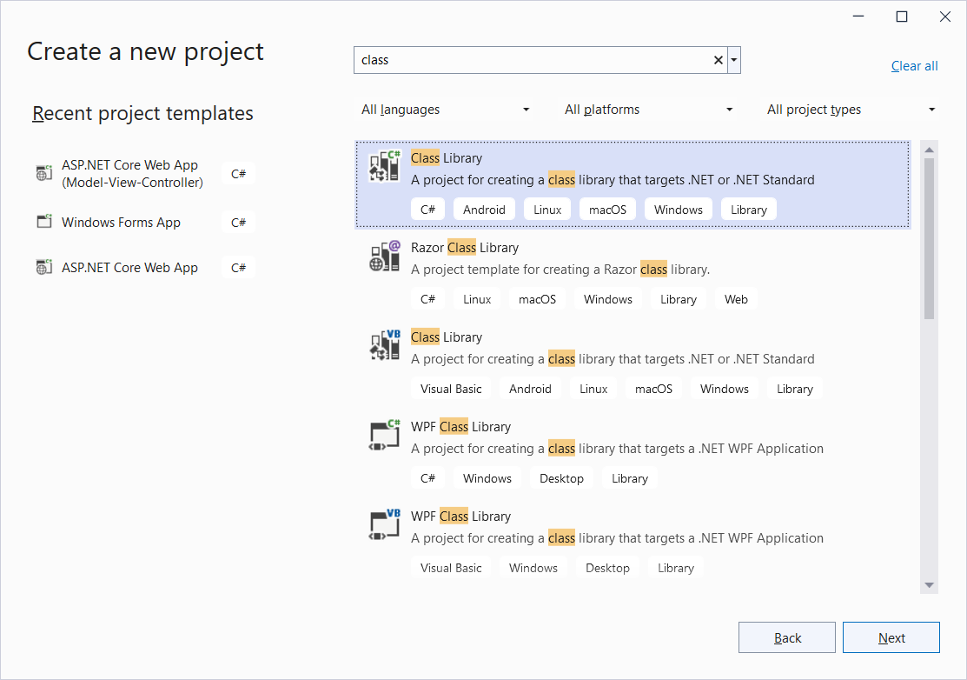
Visual Studio
New project
Class Library
Next

Slide 9
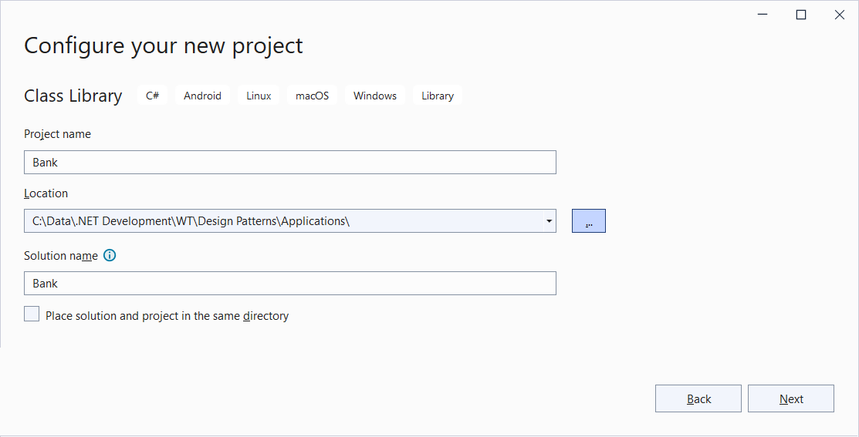
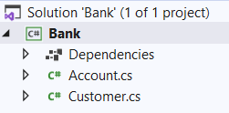
Visual studio
Project Name: Bank
Next
.NET 6.0
Application that contains all the classes needed for a banking app
Add class Account.cs
Add class Customer.cs (not used in demo)
Delete Class1.cs

Slide 10
Class Account
public class Account
{
private double balance = 0;
public void Credit(double amount)
{
balance += amount;
}
public void Debit(double amount)
{
if (balance > amount)
{
balance -= amount;
}
}
public double Balance
{
get { return balance; }
}
}

Slide 11
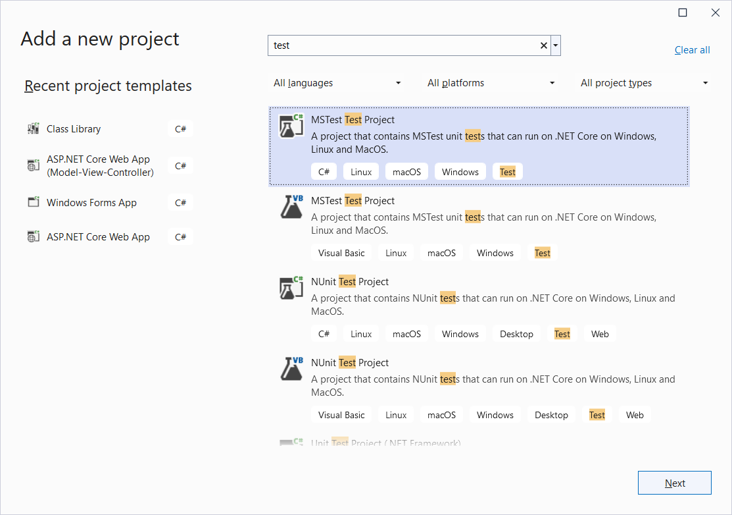
Add MsTest Test Project
Solution | Add |
New Project
MSTest Test Project
Next

Slide 12
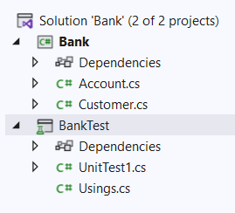
Add MsTest Test Project
Project Name: BankTest
Next
.NET 6.0
Create
BankTest is a Class Library that contains all the test classes needed for unit testing the classes in the Class Library Bank

Slide 13
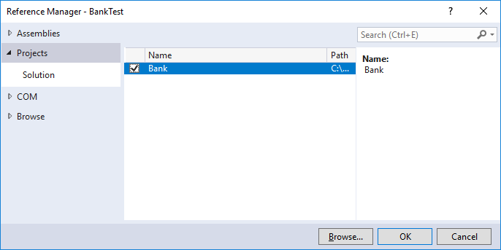
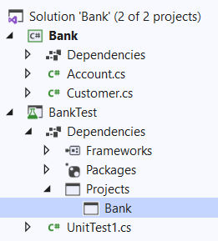
Project Reference
Add reference from test project BankTest to project to be unit tested Bank
BankTest (right click) | Add | Project Reference

Slide 14
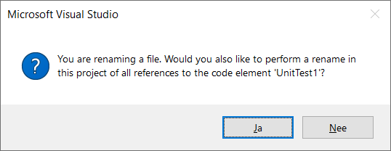
Class AccountTest
Rename UnitTest1.cs into AccountTest.cs
We'll use the AccountTest class to test our Account class

Slide 15
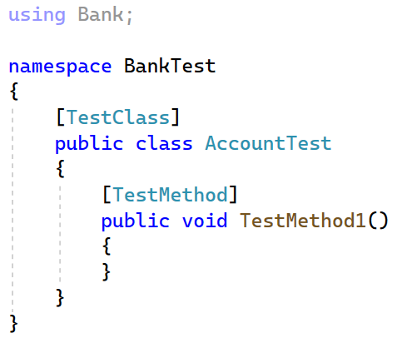
Class AccountTest
Using makes it able to call into the Bank project under test
The [TestClass] attribute is required on any class that contains unit test methods that you want to run in Test Explorer.
Each test method that you want Test Explorer to recognize must have the [TestMethod] attribute.

Slide 16
Writing test methods
To write a test method, you should follow the AAA pattern which splits up the code in 3 actions. Following this pattern, the test code becomes well structured and easy to understand.
The Arrange section of a unit test method initializes objects and sets the value of the data that is passed to the method under test.
The Act section invokes the method under test with the arranged parameters.
The Assert section verifies that the action of the method under test behaves as expected.

Slide 17
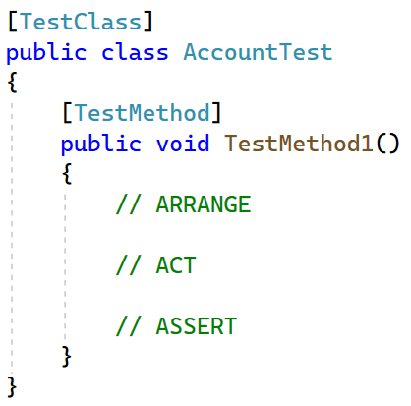
Arrange – Act – Assert pattern
Arrange
Initialize data
Act
Method calls
Assert
Test the result is as expected

Slide 18
Naming conventions test methods
public void TestedMethod_InitialState_ExpectedState()
The name of your test should consist of three parts:
The name of the method being tested.
The initial state of the variables, objects used in the test
The expected state after calling the method
Naming standards are important because they explicitly express the intent of the test.
e.g. void Add_MaximumNumber_ThrowsOverFlowException()

Slide 19
Write your first test method
[TestMethod]
public void Constructor_Balance0_Returns0()
{
// ARRANGE
// ACT
// ASSERT
}

Slide 20
Write your first test method
[TestMethod]
public void Constructor_Balance0_Returns0()
{
// ARRANGE
Account account = new Account();
// ACT
double balance = account.Balance;
// ASSERT
// check the state after the method call and make the test pass if the actual value is as expected
}

Slide 21
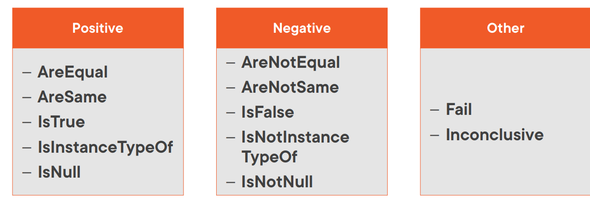
Assert class
Contains a collection of methods to test various conditions within unit tests. If the condition being tested is not met, an exception is thrown.
- ThrowsException
Notes:
Equal for variables
Same for objects Inconclusive test is a test for which you cannot determine the result. For example, what if you had a test that uses some kind of an external resource (Internet connection, for example). If the connection is currently not available, this doesn't really mean the test is a failure. On the other hand, you shouldn't just mark it as successful without actually running it through. So you mark it as inconclusive and this can be seen in the test report.

Slide 22
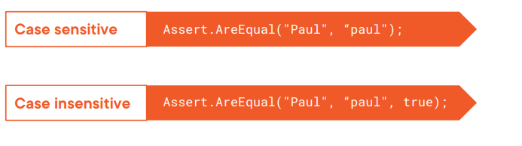
Assert Class
Example: Checking String Equality
Notes:
True indicates a case-insensitive comparison : IgnoreCase = True

Slide 23
Exercise: Write your first ASSERT
[TestMethod]
public void Constructor_Balance0_Returns0()
{
// ARRANGE
Account account = new Account();
// ACT
double balance = account.Balance;
// ASSERT
// check the expected state after the method call??
}

Slide 24
Solution: Write your first ASSERT

Slide 25
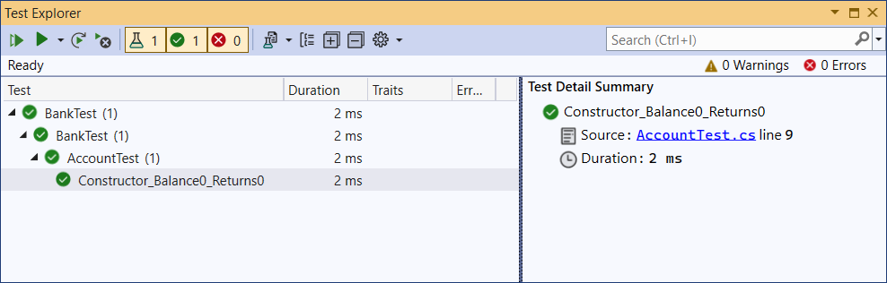
Run test
Test | Run All Tests → Test Explorer window opens

Slide 26
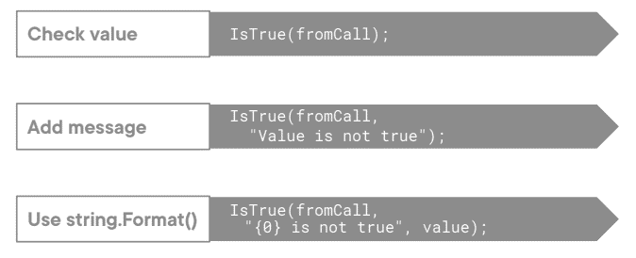
Assert Class
Add message for Test Explorer

Slide 27
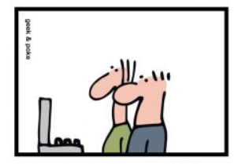
Assert Class
Assert.IsFalse? SHOULDN’T IT BE Assert.IsTrue?
WITH Assert.IsTrue THE TEST WENT RED

Slide 28
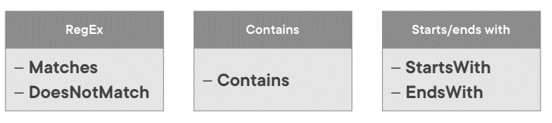
StringAssert Class
Provides some useful methods for string evaluation

Slide 29
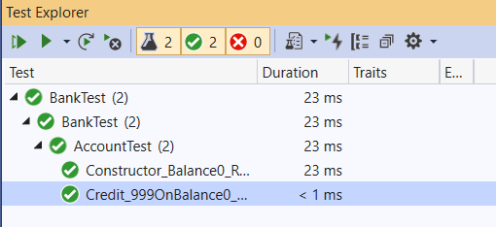
Exercise: Write your second test method
[TestMethod]
public void Credit_999OnBalance0_Returns999()
{
// ARRANGE
// ACT
// ASSERT
}

Slide 30
Exercise: Write your second test method

Slide 31
Exercise: Write your third test method
[TestMethod]
public void Debit_500FromBalance500_Returns0()
{
// ARRANGE
// ACT
// ASSERT
}

Slide 32
Exercise: Write your third test method

Slide 33
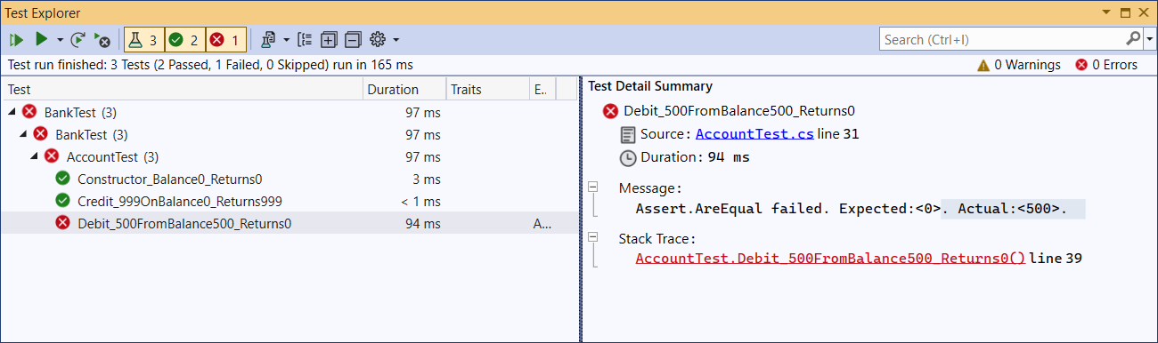
Run all your tests

Slide 34
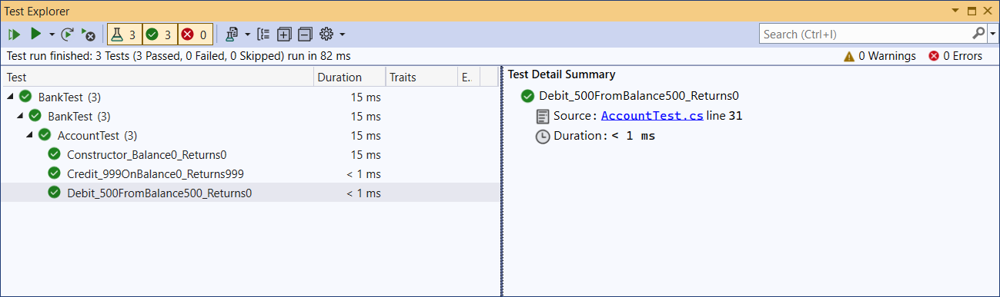
Correct your code!
and run your tests again

Slide 35
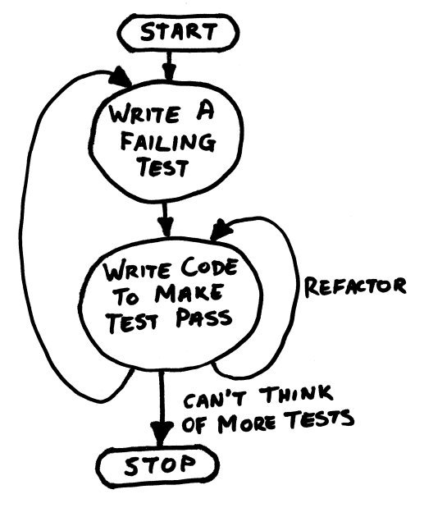
Test Driven Development (TDD)
Write tests first, code afterwards.
Facilitates the development of valid code in all circumstances and thus guarantees more accurate and reliable code.

Slide 36
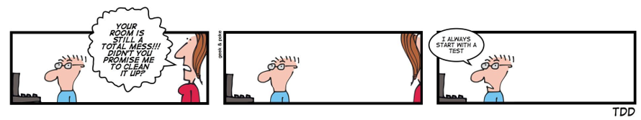
TDD

Slide 37
Exercise
Add a test for an exceptional case like crediting an account with a negative amount. In that case an ArgumentOutOfRangeException should be thrown.
[TestMethod]
public void Credit_NegativeAmount_ReturnsOutOfRangeException()
{
// ARRANGE
Account account = new Account();
// ASSERT
Assert.ThrowsException<ArgumentOutOfRangeException>(
() => account.Credit(-200) // ACT
);
}

Slide 38
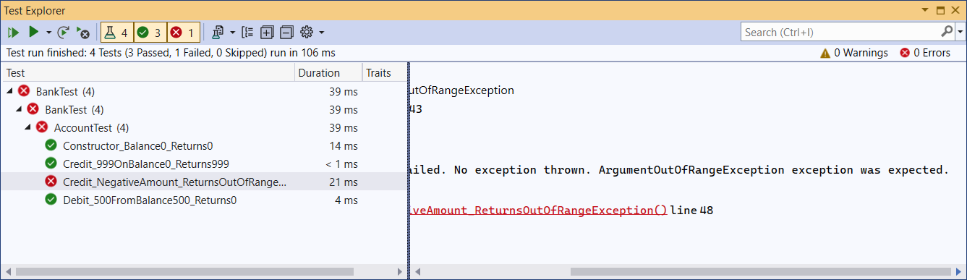
Run your tests

Slide 39
Exercise: Rewrite the Credit method
public void Credit(double amount)
{
balance += amount;
}
All tests should pass!

Slide 40
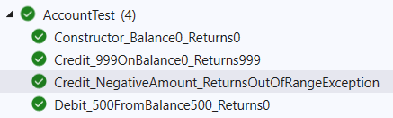
Exercise: Rewrite the Credit method

Slide 41
Application Specific Exceptions
In case of a banking app a BalanceInsufficientException would make sense. Every time an account is debited by an amount bigger than the account’s balance total the payment should be cancelled.
Add the class BalanceInsufficientException to the Bank project.
namespace Bank
{
public class BalanceInsufficientException : ApplicationException { }
public class Account
{
...

Slide 42
Exercise: Test method
[TestMethod]
public void Debit_AmountBiggerThanBalance_ThrowsBalanceInsufficientException()
{
// ARRANGE
// ACT
// ASSERT
}

Slide 43
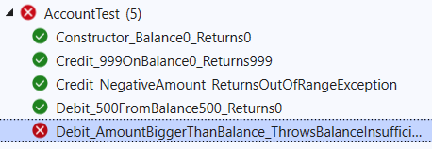
Exercise: Test method

Slide 44
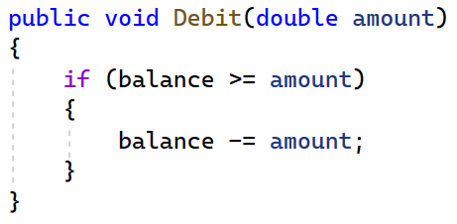
Exercise: Rewrite your Debit method
All tests should pass!

Slide 45
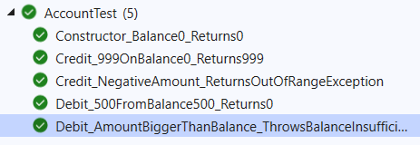
Exercise: Rewrite your Debit method

Slide 46
Exercise StringCalculator Kata
TDD Katas are exercises designed to help programmers improve their TDD skills. The idea behind a Kata is to learn by repeating over and over again.
Remember the steps:
Write a failing test
Write the minimum code to make your test pass
Refactor
Keep repeating those steps again and again as many times as you can and you will master the craft of TDD.

Slide 47
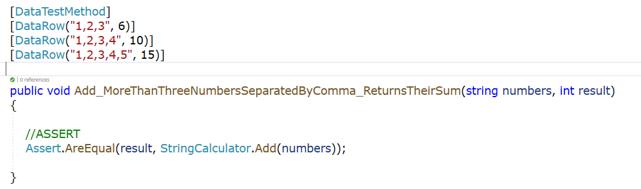
Exercise StringCalculator Kata
In this exercise parameterized tests are introduced in order to pass in different testcases via the DataRow attribute

